Slide 1
Loan Approval Prediction
Suraj Andhe (02) Shubham Nalawade (61) Siddhesh Parab (65)
Date of presentation : 30-04-2022
Under the guidance of Prof. Amruta Sankhe
Group No. 10
Atharva College of Engineering
Department of Information Technology
2021-22

Slide 2
Content
Introduction
Problem definition & Proposed solution
Scope of project
Review of literature
System description
Methodology
Algorithms
Hardware and Software Requirements
Test cases
Results and Discussion
Conclusion
Future Scope
Literature Cited
Publication by the group
Acknowledgements

Slide 3

Introduction
Financial companies approves loan after a regress process of verification and validation but still there is no surety whether the chosen applicant is right applicant or not.
Lots of people are applying for bank loans but the bank has its limited assets which it has to grant to limited people only.

Slide 4
Problem Definition & Proposed Solution
The bank employees have to check all the customer details , payment history , credit score ,etc . before taking the decision of loan approval.
Requires manpower and also a lot of time.
To solve this problem we have developed a proposed system that will predict whether to approve loan or not .

Slide 5
Scope of Project
Pick out which customer will be able to pay the debt.
This system will help to predict whether the loan should be approved or not .
Logistic regression, knn, naive bayes and random forest are used for creating a model that is accurate and less error percentage.

Slide 6
Review of Literature
Sr.No | Title | Authors | Description | Accuracy
1 | An Approach for Prediction of Loan Approval using Machine Learning Algorithm IEEE(2020) | Mohammad Ahmad Sheikh; Amit Kumar Goel; Tapas Kumar | In our banking system, banks have many products to sell but main source of income of any banks is on its credit line. | 81.11% (Logistic Regression)
2 | Loan Default Forecasting using Data Mining IEEE (2020) | Bhoomi Patel, Harshal Patil, Shree Jaswal | Assessment of default on a debt is a crucial process that should be done banks to help them to assess if a loan applicant can be a defaulter | 84.03% Gradient Boosting 83.51% Random Forest 49.63% Logistic Regression

Slide 7
Sr. No | Title | Authors | Description | Accuracy
3 | Application of Machine Learning in Credit Risk Assessment: A Prelude to Smart Banking IEEE (2019) | Sazzad Hossain , Hossain Arif , Samiul Islam | An ever-changing economy as the rate of loan defaults are gradually increasing, authorities are finding it difficult to assess loan requests and tackle the risks of loan defaulters | 85.1% Logistic Regression 84.5% SVM 85.4% Random Forest
4. | Prediction of loan status in commercial bank using machine learning classifier IEEE (2018) | G. Arutjothi; C. Senthamarai | Banking Industry always needs a more accurate predictive modeling system for many issues. Predicting credit defaulters is a difficult task for the banking industry. | 75.08% (K nearest Neighbour)
5. | Predective and Probalistic approach using Logistic Regression IEEE(2017) | Ashlesha Vaidya | This paper adheres to logistic regression as a machine learning tool in order to approach to the problem of loan approval prediction | Logistic Regression (Accuracy Not Mentioned)

Slide 8
Sr. No. | Title | Authors | Description | Accuracy
6. | Loan Prediction using Decision Tree and Random Forest IRJET(2020) | Kshitiz Gautam , Arun Pratap Singh , Keshav Tyagi , Mr. Suresh Kumar | The aim of this paper is to find the nature or background or credibility of the client that is applying for the loan. We use exploratory data analysis technique to deal with the problem of approving or rejecting the loan request or in short loan prediction. | 62.12% Decision Tree 85.75% Random Forest
7. | Prediction of Loan Approval using Machine Learning Algorithm: A Review Paper IRJET(2021) | Kathe Rutika Pramod , Panhale Sakshi Dattatray , Avhad Pooja Prakash , Ghorpade Dinesh B. , Dapse Punam Laxman | Previous research in this era has shown that there are so many methods to study the problem of controlling loan default. But as the right predictions are very important for the maximization of profits | 81.1% Decision Tree

Slide 9
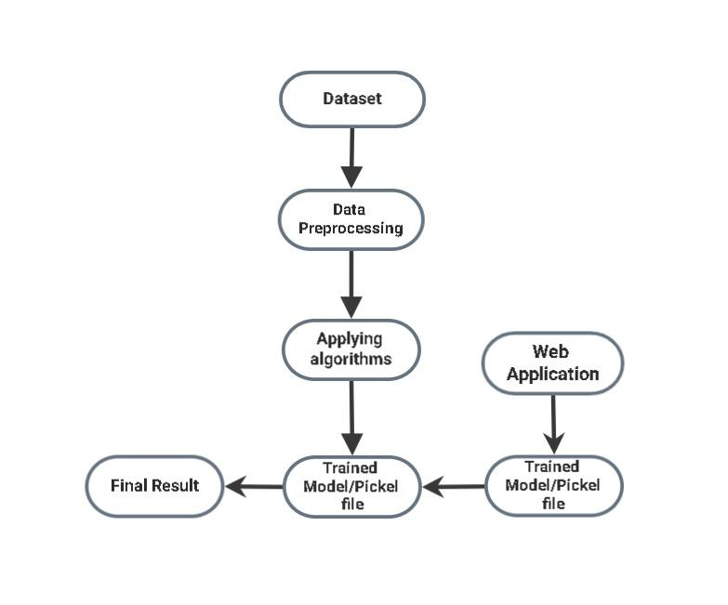
System Description
Methodology

Slide 10
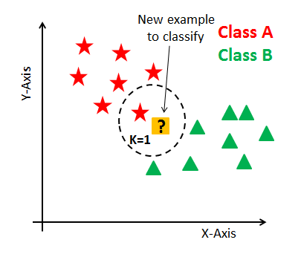

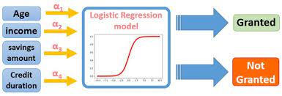
Algorithms
Random Forest
Naive Bayes
Logistic Regression
Decision Tree
K-Nearest Neighbour

Slide 11
Hardware and Software Requirements
Hardware: Laptop or PC with mouse and keyboard for inputs.
Software:
Jupyter Notebook
Pycharm
Technologies Used:
Python and its Libraries
Machine Learning algorithms
Flask for deploying the model

Slide 12

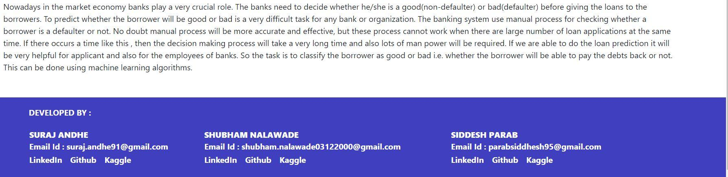
User Interface Design

Slide 13
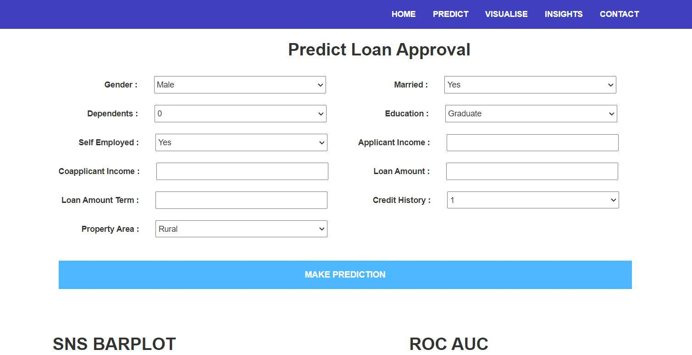
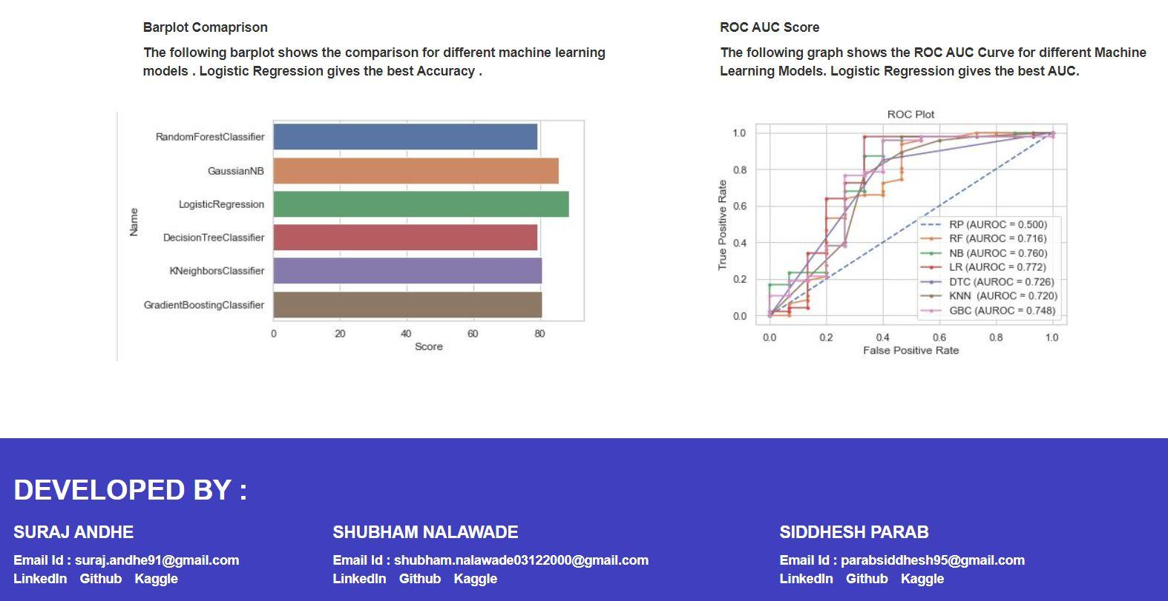

Slide 14
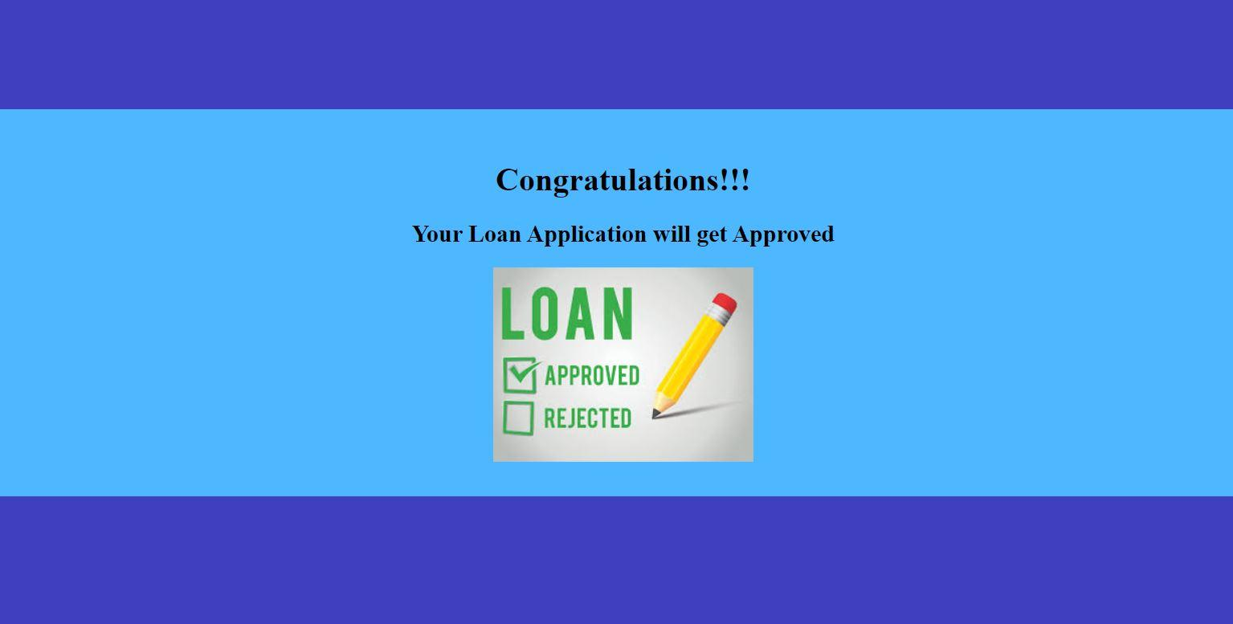
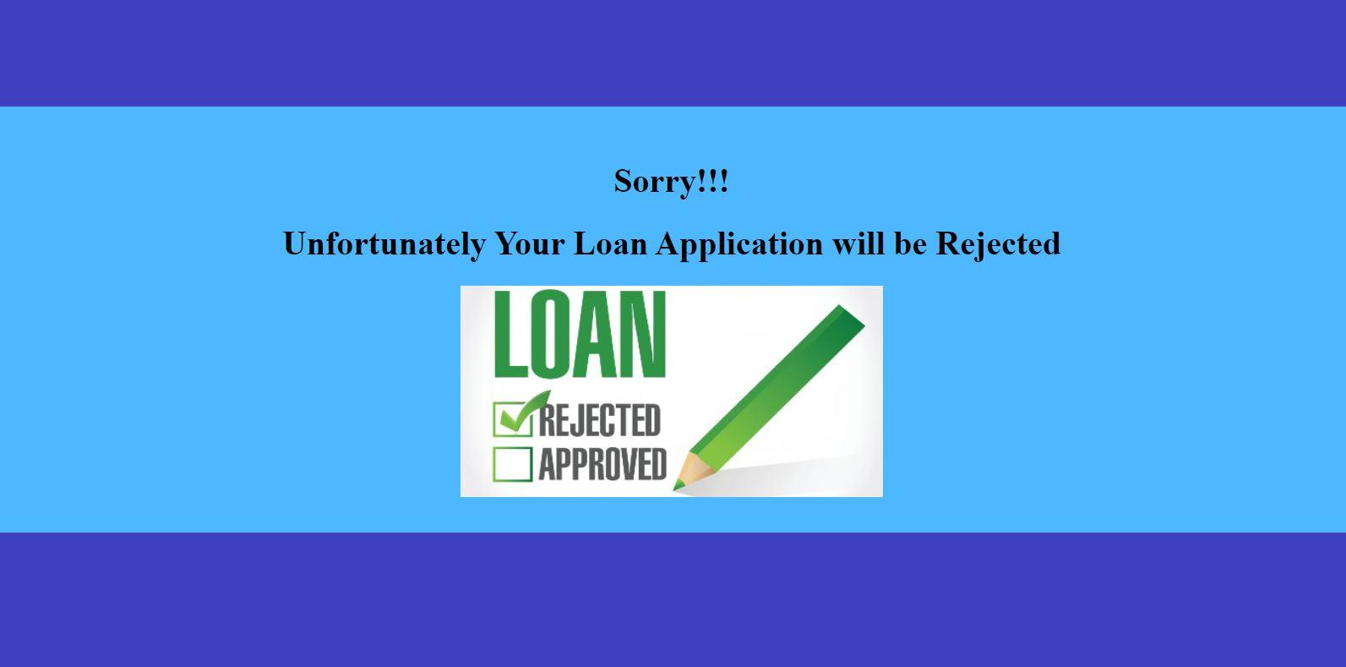

Slide 15
Test Cases
Test Case ID | Test Scenario | Test Steps | Expected Results | Actual Results | Pass/Fail
1. | Predict | Go to the Website & click on Predict button | A loan approval form will appear that contains applicant income, loan amount, etc. | As Expected | Pass
2. | Visualize | First click on predict button , then a page will appear where on the top there will be option of visualize in the menu bar, select that | Takes you to the report section which contains detail about each attribute | As Expected | Pass
3. | Insights | First click on predict button , then a page will appear where on the top there will be option of Insights in the menu bar, select that | Displays the graphs and shows which ML algorithm performs best | As Expected | Pass
4. | Contact | Click on Contact button | Shows the details of candidates who have created the project | As Expected | Pass
5. | Submit | Press the submit button after filling the loan approval form | Displays the decision whether the candidates loan should be approved or not | As Expected | Pass

Slide 16
Results and Discussions
So we have successfully compared different machine learning algorithms for the Property Loan dataset they are Random Forest , Naive Bayes , Logistic Regression and K Nearest Neighbors .
The Logistic Regression algorithm gave the best accuracy (88.70%) .

Slide 17
Comparative Analysis
Sr. No. | Algorithm | Accuracy
1. | Random Forest | 79.03%
2. | Naive Bayes | 85.48%
3. | Decision Tree | 79.03%
4. | Logistic Regression | 88.70%
5. | K Nearest Neighbour | 80.64%

Slide 18
Conclusion
Algorithms and accuracy
Factors,features and final conclusion

Slide 19
Future Scope
Improves banking procedure
Traditional process vs Online approach
Other datasets

Slide 20
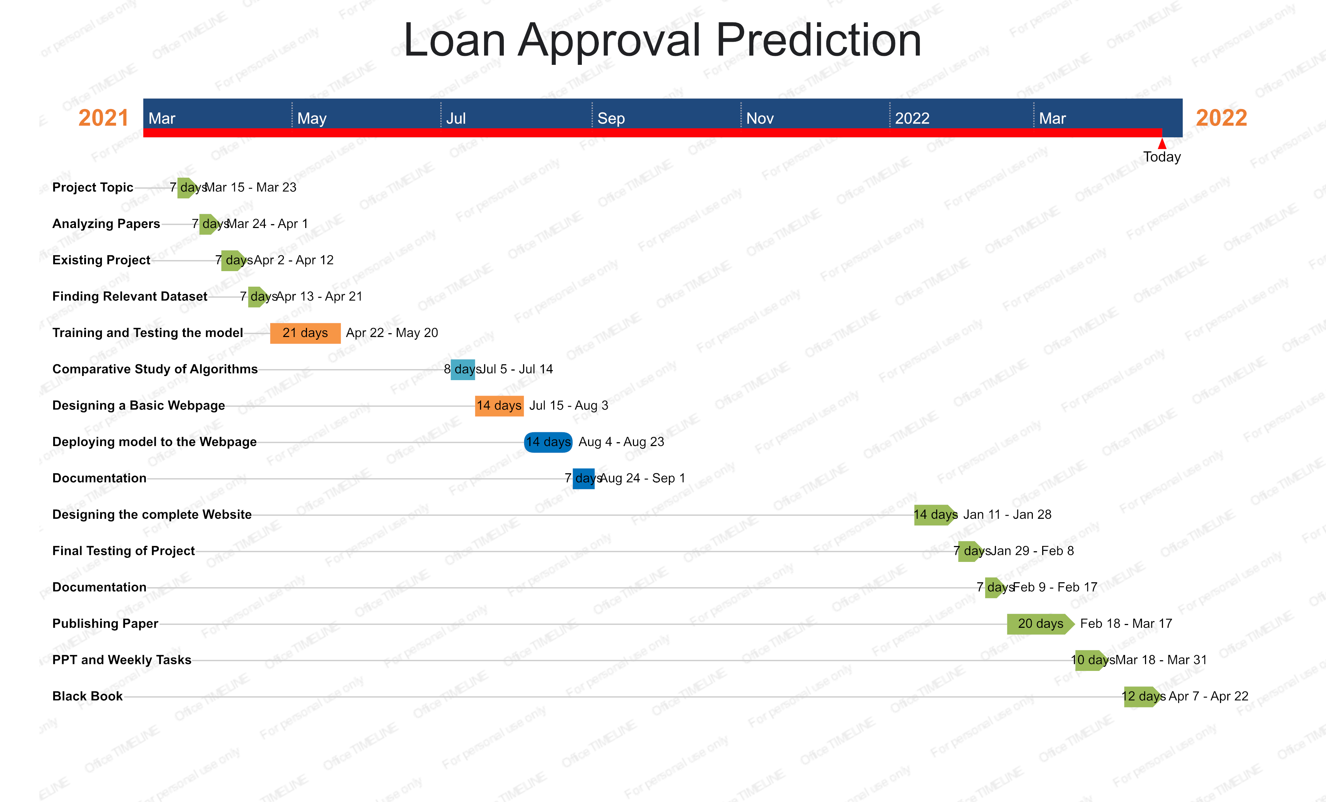
Timeline Chart

Slide 21
Literature Cited
M. A. Sheikh, A. K. Goel and T. Kumar, "An Approach for Prediction of Loan Approval using Machine Learning Algorithm," 2020 International Conference on Electronics and Sustainable Communication Systems (ICESC), 2020, pp.490-494, doi:10.1109/ICESC48915.2020.9155614.
K. Alshouiliy, A. AlGhamdi and D. P. Agrawal, "AzureML Based Analysis and Prediction Loan Borrowers Creditworthy," 2020 3rd International Conference on Information and Computer Technologies (ICICT), 2020, pp. 302-306, doi: 10.1109/ICICT50521.2020.00053.
B. Patel, H. Patil, J. Hembram and S. Jaswal, "Loan Default Forecasting using Data Mining," 2020 International Conference for Emerging Technology (INCET), 2020, pp. 1-4, doi: 10.1109/INCET49848.2020.9154100.
S. Z. H. Shoumo, M. I. M. Dhruba, S. Hossain, N. H. Ghani, H. Arif and S. Islam, "Application of Machine Learning in Credit Risk Assessment: A Prelude to Smart Banking," TENCON 2019 - 2019 IEEE Region 10 Conference (TENCON), 2019, pp. 2023-2028, doi: 10.1109/TENCON.2019.8929527.
Arutjothi ; C. Senthamarai ,” Prediction of loan status in commercial bank using machine learning classifier” 2018 International Conference Sustainable Systems(ICISS)
Ashlesha Vaidya , “Predictive and Probabilistic approach using Logistic Regression” 2017 8th International Conference on Computing, Communication and Networking Technologies
Kshitiz Gautam, Arun Pratap Singh, Keshav Tyagi, Mr. Suresh Kumar “Loan Prediction using Decision Tree and Random Forest” 2020 International Research Journal of Engineering and Technology (IRJET)
Kathe Rutika Pramod , Panhale Sakshi Dattatray , Avhad Pooja Prakash , Ghorpade Dinesh B. , Dapse Punam Laxman “ Prediction of Loan Approval using Machine Learning Algorithm : A Review Paper” 2021 International Research Journal of Engineering and Technology (IRJET)

Slide 22
Links Referred for Algorithms
https://blog.floydhub.com/naive-bayes-for-machine-learning/
https://www.javatpoint.com/logistic-regression-in-machine-learning
https://www.javatpoint.com/machine-learning-random-forest-algorithm
https://www.javatpoint.com/machine-learning-decision-tree-classificationalgorithm
https://www.javatpoint.com/k-nearest-neighbor-algorithm-formachine-learning

Slide 23
Publication by the group
Published in International Research Journal of Engineering and Technology (IRJET)
Paper Title: Loan Approval Prediction
Date of Publication: 13th April 2022
Volume: 09 Issue: 04
Link: https://www.irjet.net/archives/V9/i4/IRJET-V9I4118.pdf

Slide 24
Acknowledgement
It gives us great pleasure in presenting this project synopsis report titled: “Loan Approval Prediction”. We express our gratitude to our project guide Prof. Amruta Sankhe , who provided us with all the guidance and encouragement and made the lab available to us at any time. We also would like to deeply express our sincere gratitude to the Project coordinators. We are eager and glad to express our gratitude to the Head of the Information Technology Dept. Prof. Deepali Maste , for her approval of this project. We are also thankful to her for providing us the needed assistance, detailed suggestions and encouragement to do the project. We would like to deeply express our sincere gratitude to our respected principal Prof. Dr. Shrikant Kallurkar and the management of Atharva College of Engineering for providing such an ideal atmosphere to build up this project with well-equipped library with all the utmost necessary reference materials and up to date IT Laboratories. We are extremely thankful to all staff and the management of the college for providing us all the facilities and resources required

Slide 25
Thank You!

